Slide 1
6. Report Writing

Slide 2

Purpose: Event/Incident

Slide 3
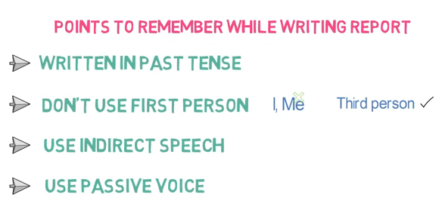

Slide 4
Indirect speech:
You said you'd had a headache the day before yesterday.
Direct speech:
“It's been raining since this afternoon.”
Indirect speech:
He said it'd been raining since that afternoon.
Direct speech:
“I haven't seen them since last week.”

Slide 5
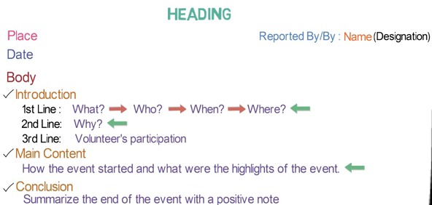

Slide 6
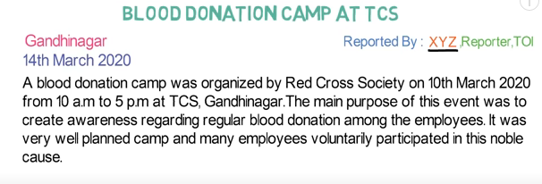
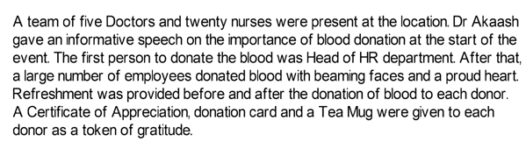


Slide 7
General Report
A general report is a document that contains information on outcomes, results, and efficiencies, and other things that are directly related to the companies/groups success. It is written for a broad audience by means of plain language. The target audience can be members of your department, managers or your CEO.

Slide 8
Progress Report
A progress report is a report in which you are updating information about a project.
Progress reports make it possible for management and clients to stay informed about a project and to change or adjust assignments, schedules, and budgets.
There are three major formats for a progress report:
Memo, which is short and is only used for reports within an organization.
Letter or email, which is short and can be used for reports within or outside an organization.
Formal report, which is longer and is generally only used for reports shared outside an organization.

